Slide 1


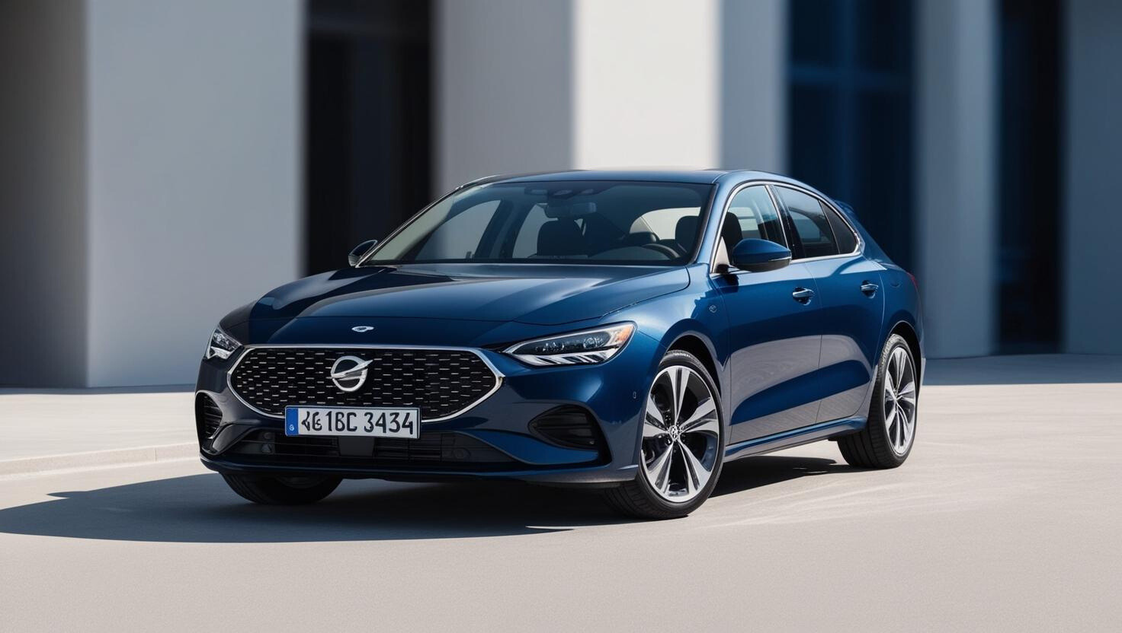

RentN’Go
DRIVE YOUR WAY WITH RENTN’GO

Slide 2



Introduction
RentN’Go: A Java-based car rental system offering affordable, on-demand vehicles.
Features: Variety of cars and driver services.
Roles:
Admin: Manages bookings, drivers, and customers.
Customer: Books cars, updates profiles, and makes payments.
Goal: Flexible and efficient car rental management.
22i-0957 Ayishah 22i-1044 MohibUllah Iftikhar 22i-1217 Maryam Farooq

Slide 3

Functional and Nonfunctional Requirements
Functional Requirements:
Manage cars: Add, search, update, and delete cars with details like model, color, and charges.
Manage bookings: create, update, delete, calculate charges, and track details (user, car, driver, payment).
Process payments securely and track statuses (pending/completed).
Assign drivers to bookings and support car delivery.
Perform CRUD operations for all entities (cars, bookings, users, drivers, payments).
Register users, manage logins, and track booking/payment history.
Nonfunctional Requirements:
Scalability: Support increasing cars, bookings, and users over time.
Availability: Ensure minimal downtime and graceful error handling.
Security: Protect sensitive data with encryption and secure logins.
Usability: Intuitive interface with clear feedback and error messages.
Maintainability: Modular, well-documented code for easy updates.
Reliability: Ensure consistent and accurate data handling.

Slide 4

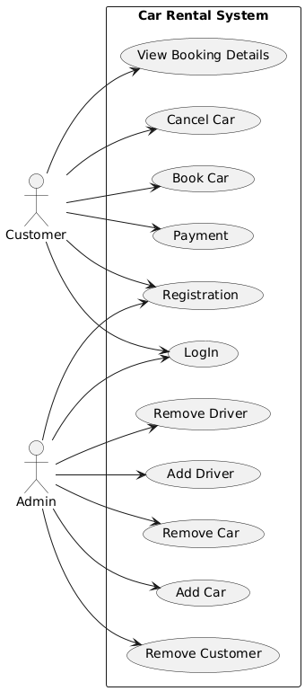
Use Case Diagram
Register/Login: Manage user registration and login.
Admin Management: Add, remove, and update admin accounts.
Customer Management: Add, remove, update, and search customer accounts.
Car Management: Add, remove, and search cars by attributes.
Booking Management: Create, update, delete, and search bookings.
Payment Processing: Handle payments and update payment status.

Slide 5
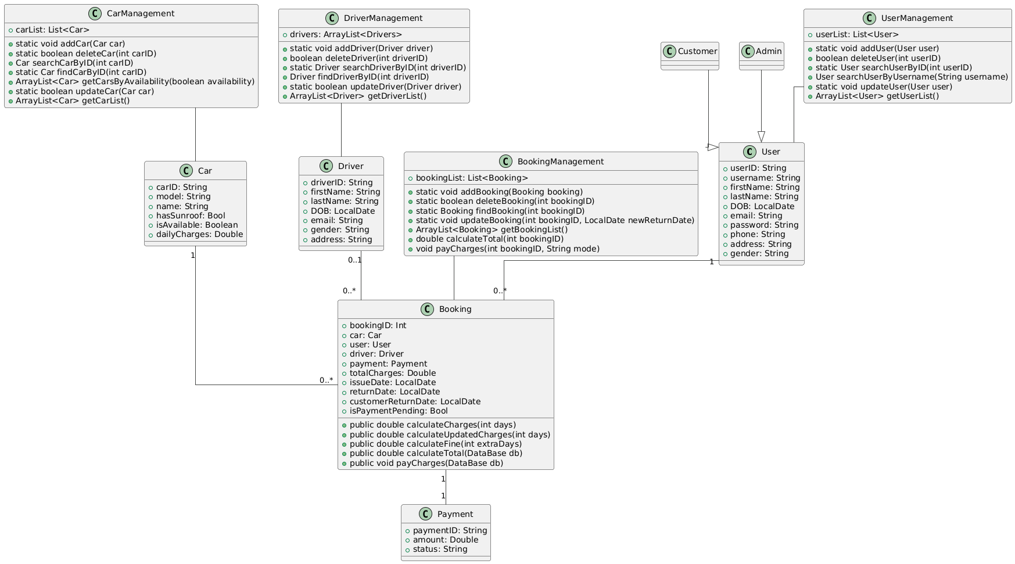
Class Diagram

Slide 6
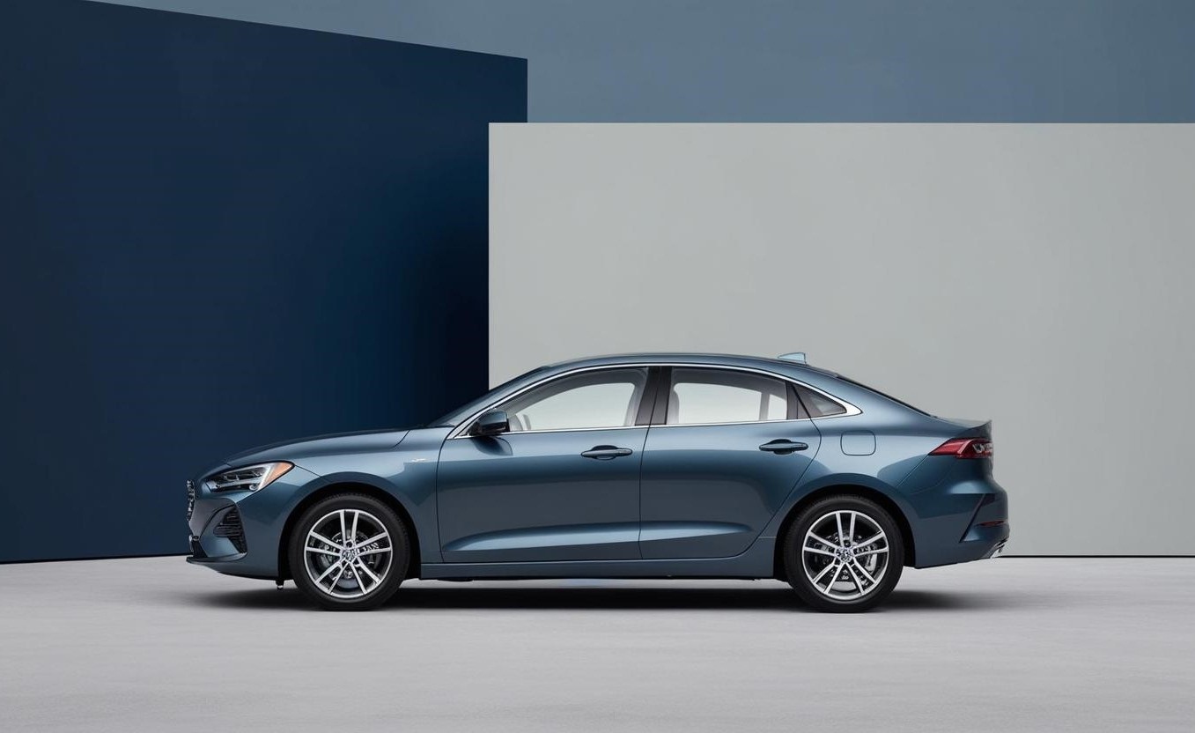
GoF Pattern
CarRentalManagement :
It uses the Façade Design Pattern to simplify access to subsystems like management classes and the database. Clients interact with it directly, without needing to know internal details or relationships (e.g., calling addUser instead of userManager.addUser).

Slide 7

GRASP
CarRentalManagement :
Controller, Creator, Information Expert,
High Cohesion, Low Coupling, Pure Fabrication
UserManagement
Controller, Creator, Information Expert,
High Cohesion, Low Coupling
CarManagement
Controller, Creator, Information Expert,
High Cohesion, Low Coupling
DriverManagement
Controller, Creator, Information Expert,
High Cohesion, Low Coupling
BookingManagement
Controller, Creator, Information Expert,
High Cohesion, Low Coupling

Slide 8
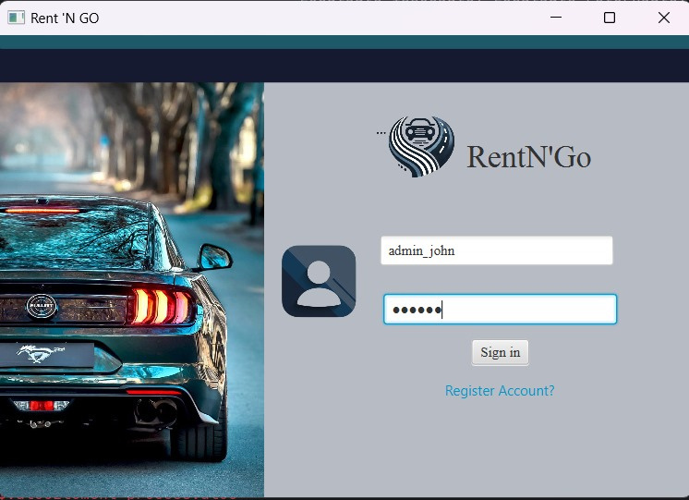
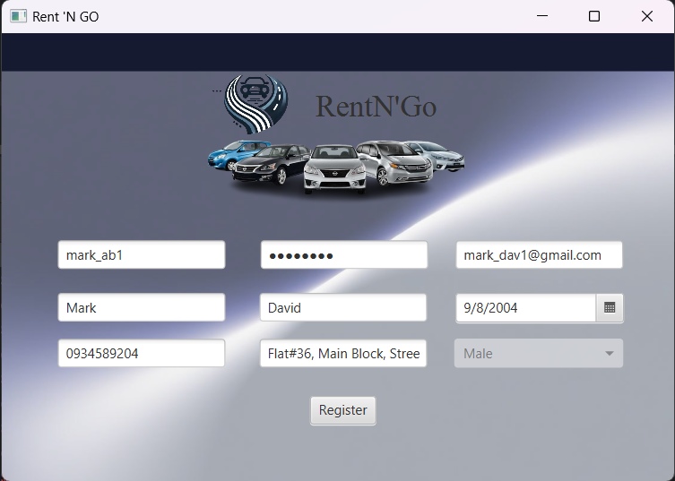
User Interface(JavaFX)
Login/Registration

Slide 9
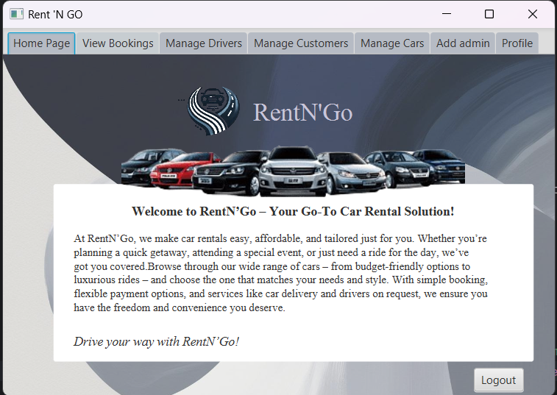
User Interface(JavaFX)
Admin Homepage

Slide 10
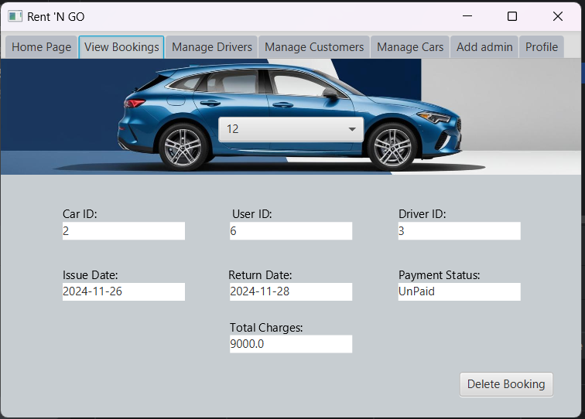
User Interface(JavaFX)
Admin Interface

Slide 11
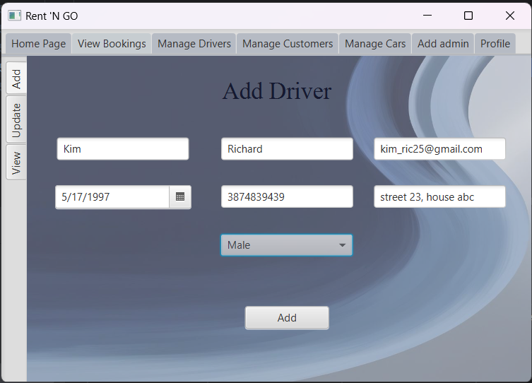
User Interface(JavaFX)
Admin Interface

Slide 12
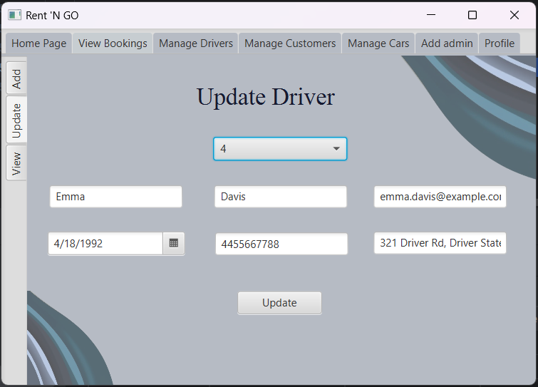
User Interface(JavaFX)
Admin Interface

Slide 13
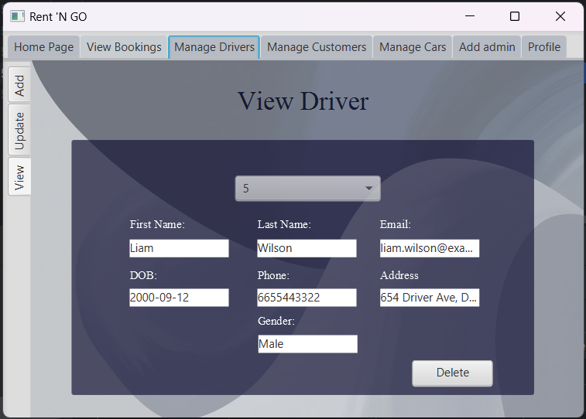
User Interface(JavaFX)
Admin Interface

Slide 14
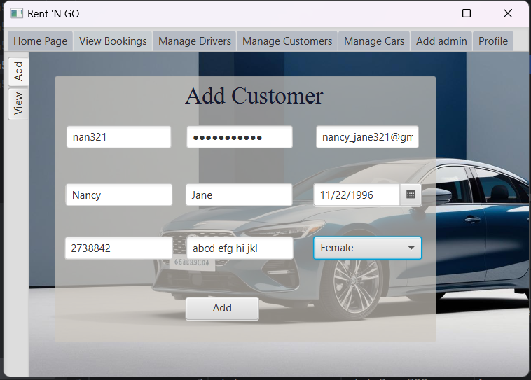
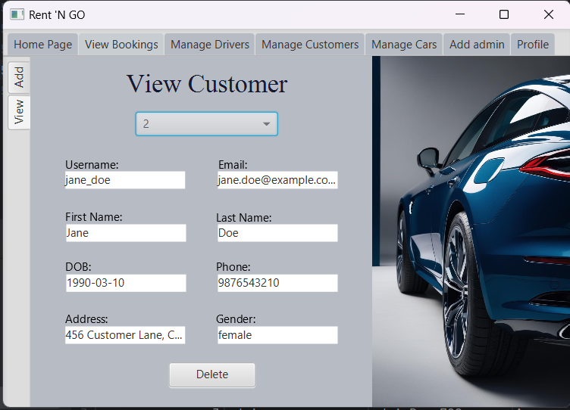
User Interface(JavaFX)
Admin Interface

Slide 15
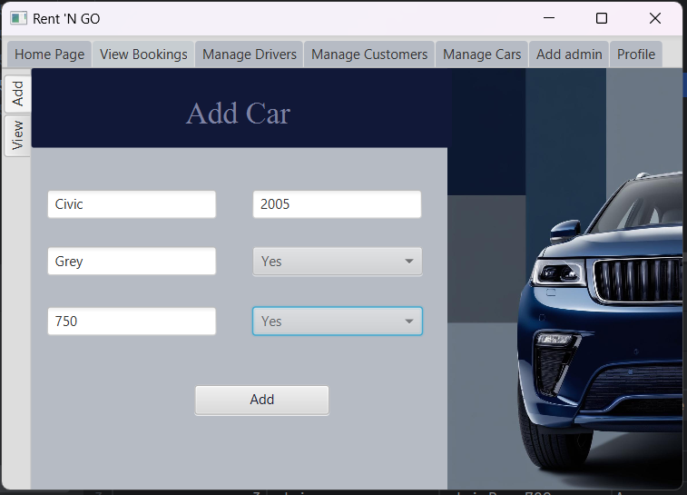
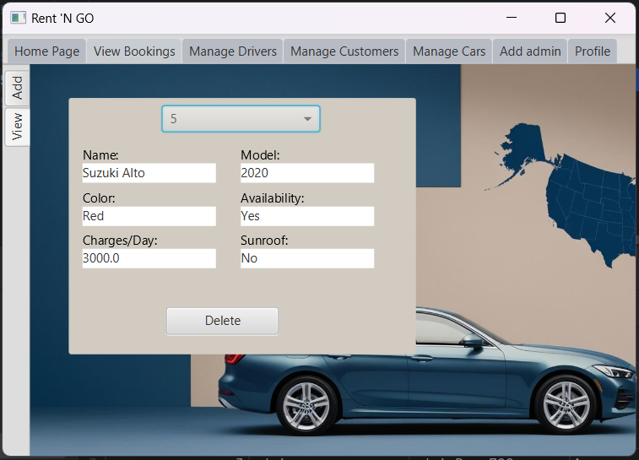
User Interface(JavaFX)
Admin Interface

Slide 16
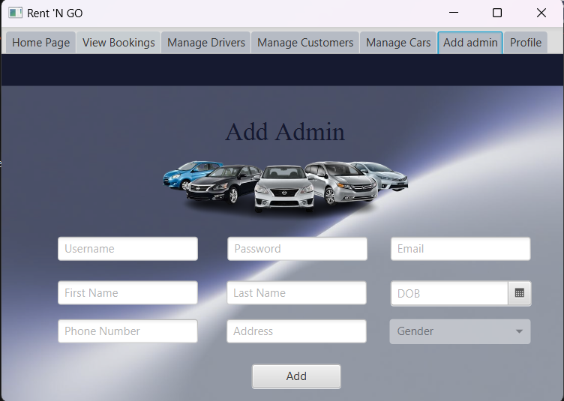
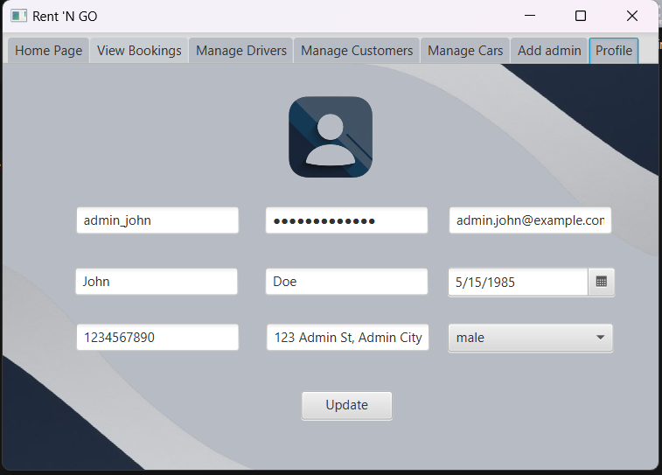
User Interface(JavaFX)
Admin Interface

Slide 17
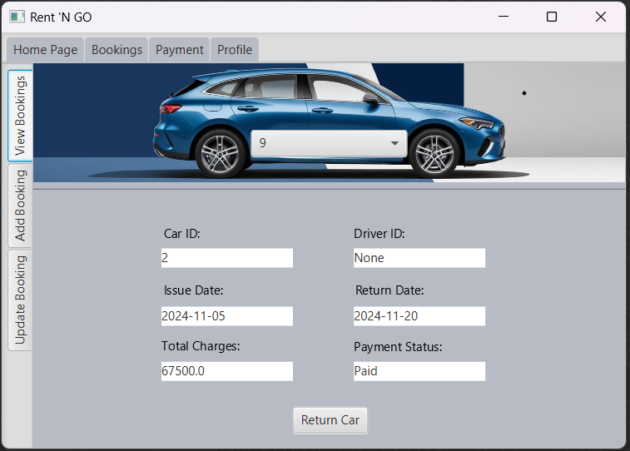
User Interface(JavaFX)
Customer Interface

Slide 18
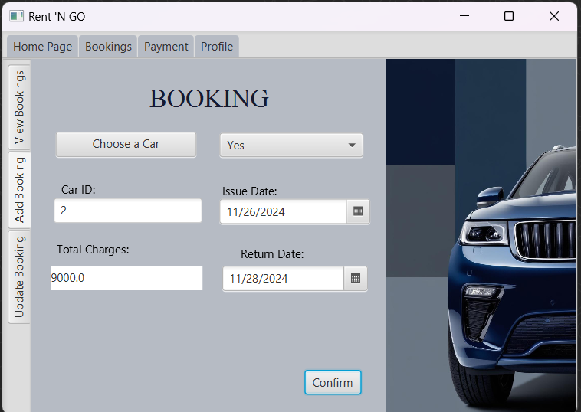
User Interface(JavaFX)
Customer Interface

Slide 19
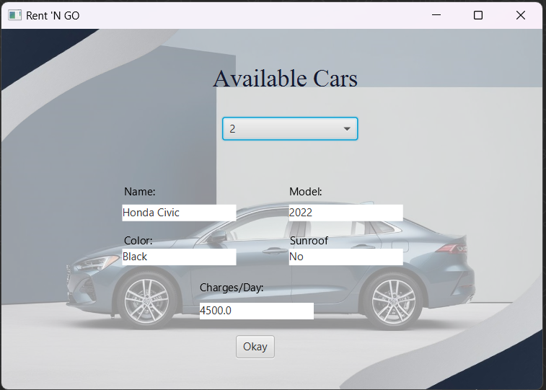
User Interface(JavaFX)
Customer Interface

Slide 20
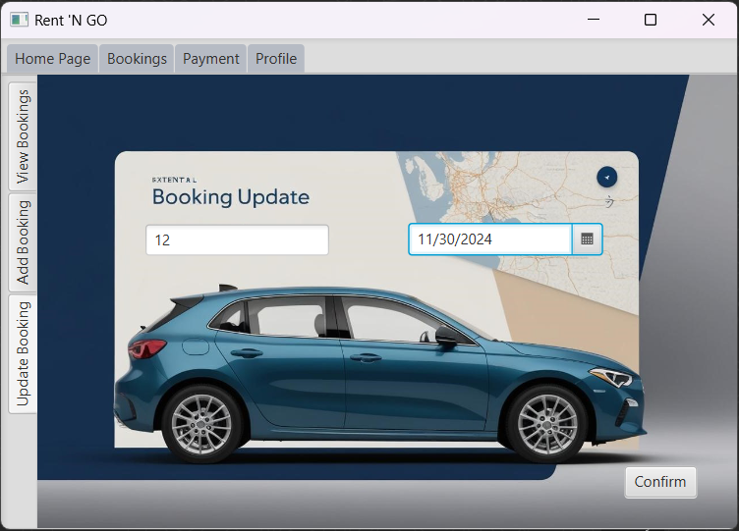
User Interface(JavaFX)
Customer Interface

Slide 21
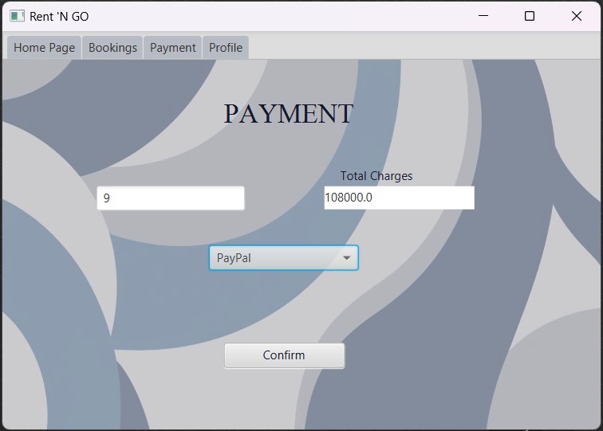
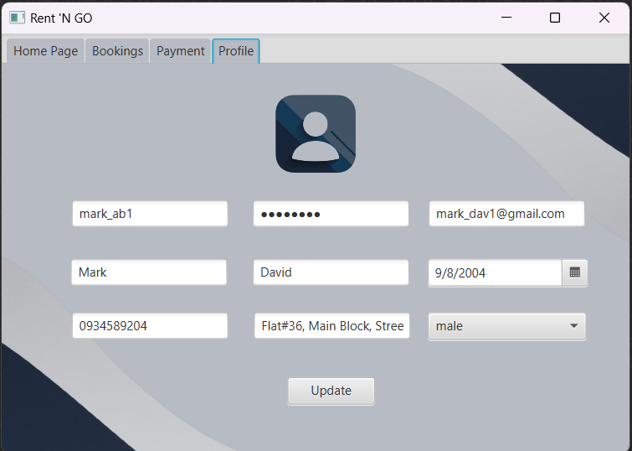
User Interface(JavaFX)
Customer Interface

Slide 22
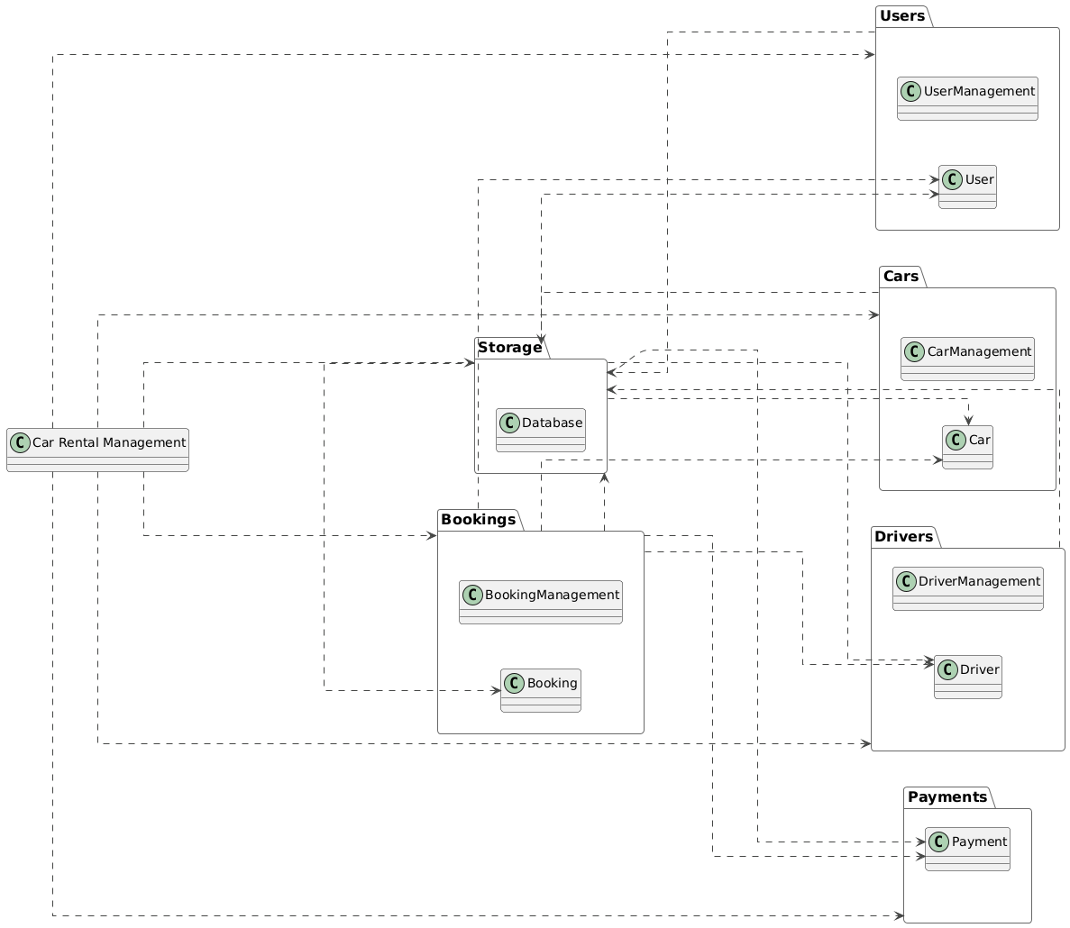
Package
Diagram

Slide 23
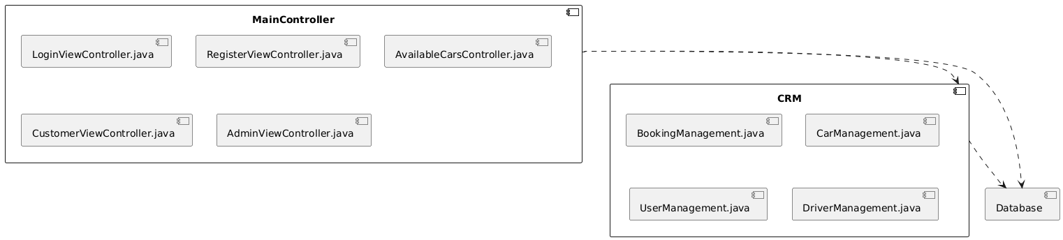
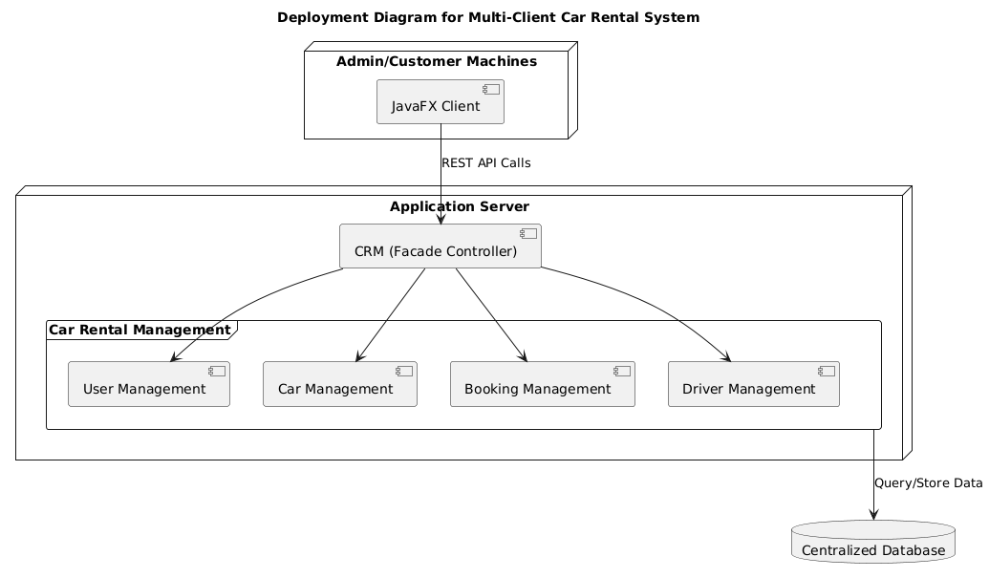
Component Diagram
Deployment Diagram

Slide 24
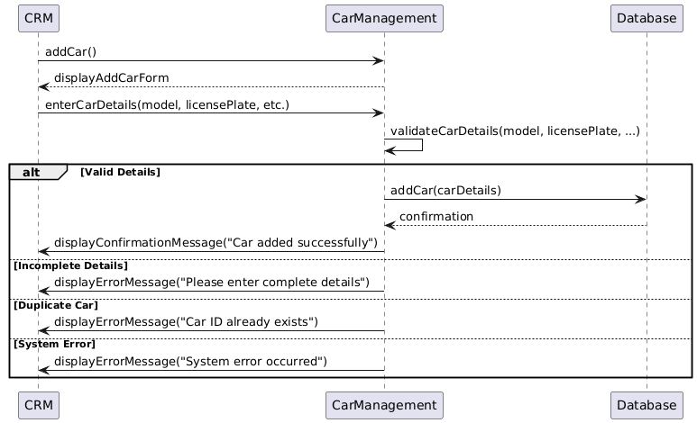
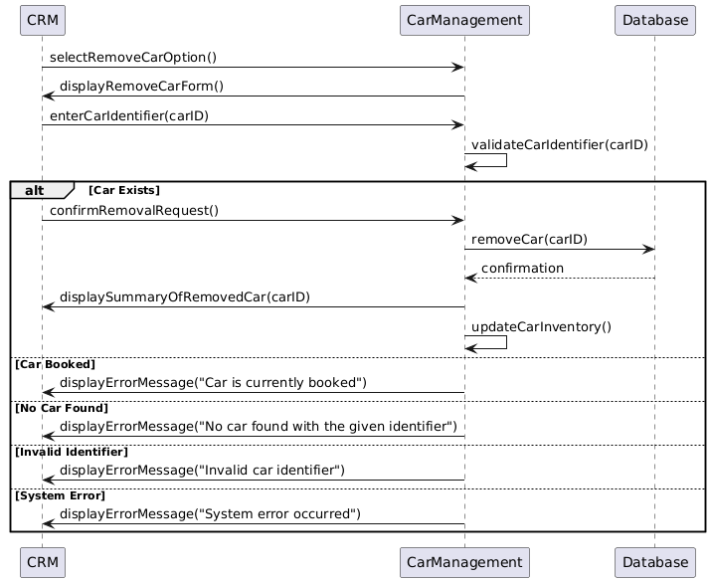
Sequence Diagram
Add Car
Delete Car

Slide 25
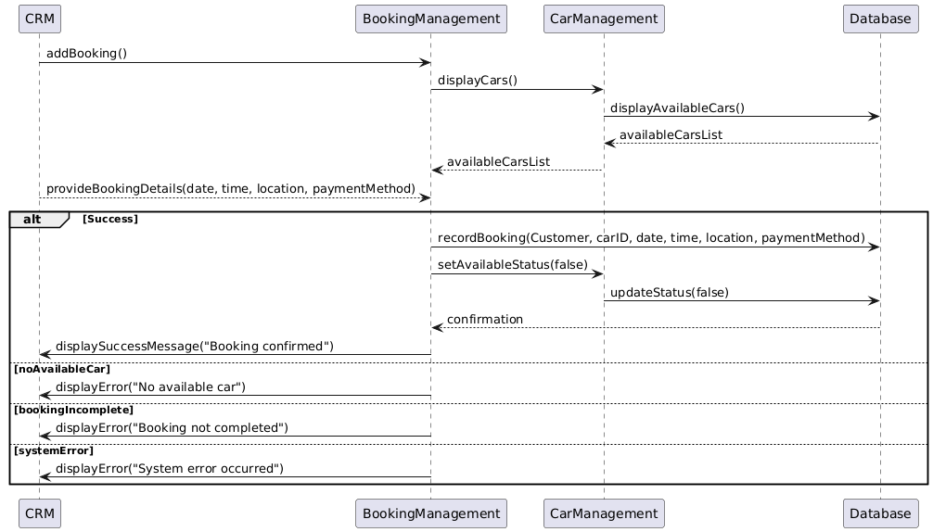
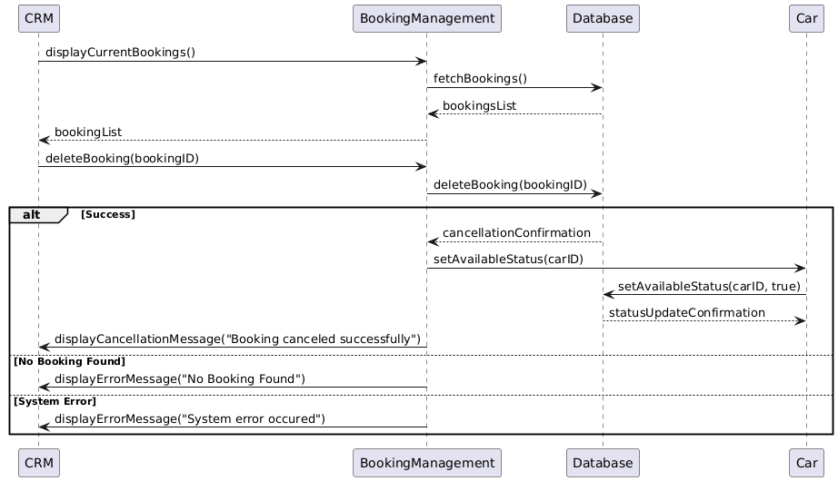
Sequence Diagram
Add Booking
Cancel Booking

Slide 26
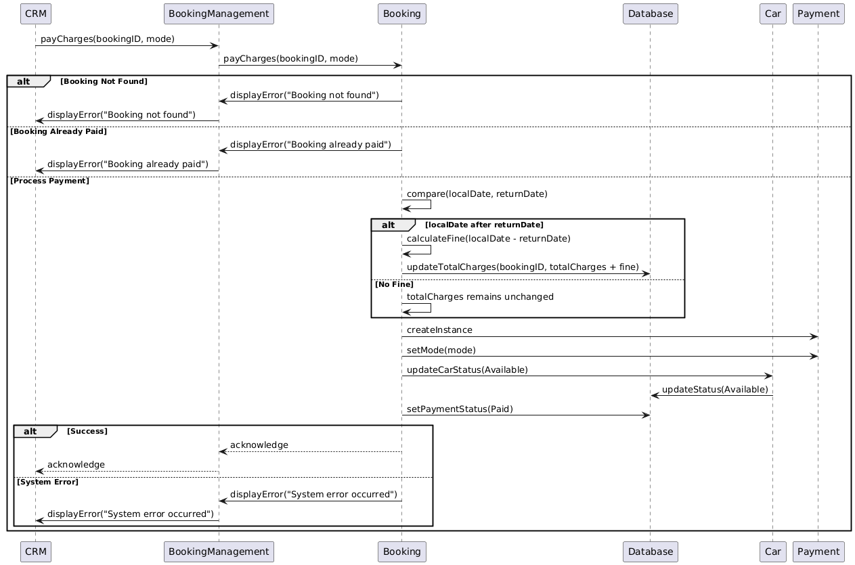
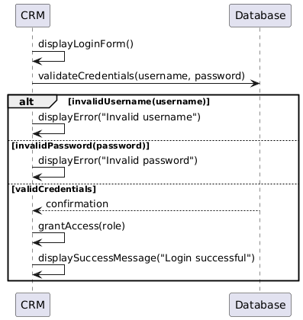
Sequence Diagram
Payment
LogIn

Slide 27


Thank You!

